Slide 1
07 Nights 08 Days
Total Trip Holidays

Slide 2
WARM WELCOME TO KASHMIR
First of all we would like to thank you for providing us a chance for serving you and your family. We would be more than happy to extend our complete support to make sure that your Kashmir tour becomes memorable.

Slide 3
GUEST DETAILS
Guest Name :-
Arrival date :-
Departure Date :-
No of Nights :-
Meal Plan :-
No of Adults :-
No of children :-
Contact No :-
Mr. Shaik Salman
08 NOV 2022
15 NOV 2022
07 Nights 08 Days
MAP
2
00
+91-7021435782

Slide 4
Itinerary

Slide 5
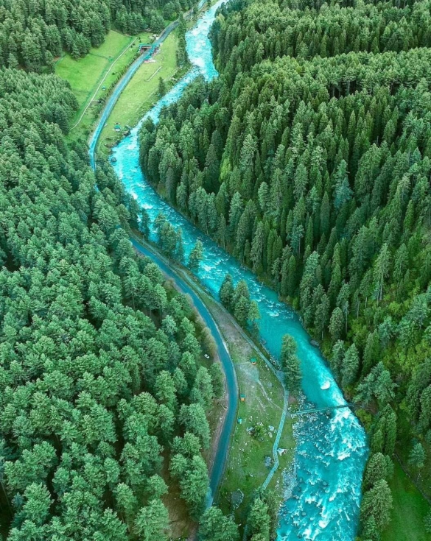
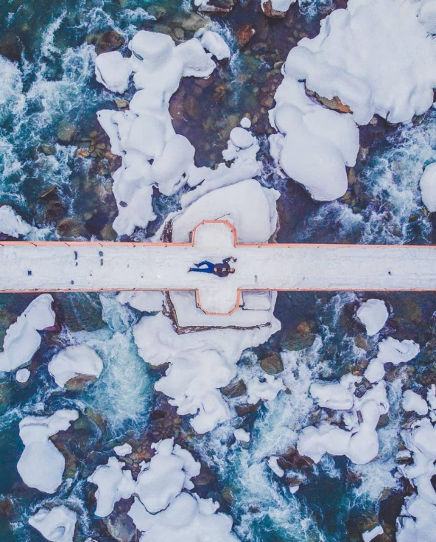
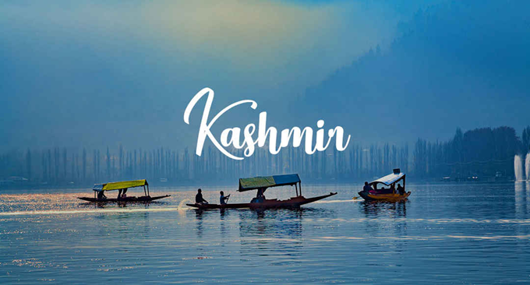
Day 1: Arrival To Srinagar With local Sightseeing
On your arrival in Srinagar Airport you will be greeted by our travel guide cum driver. After brief introduction, proceed towards your stay. You will enjoy the sightseeing of Srinagar. It is one of the most gorgeous destination in the country. However the moment you get off your flight the sight of extra security outside the airport. Make sure you explore the Mughal Gardens . You will feel the life here is regular, and is like any other city with everyone busy with their work.

Slide 6
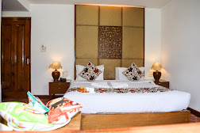
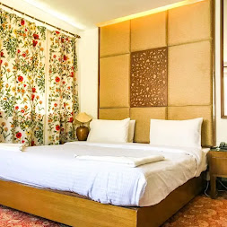
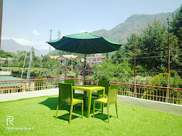
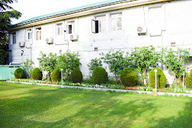
HOTEL PARADISE GATEWAY
Night: 1st & 2nd

Slide 7
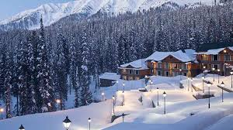
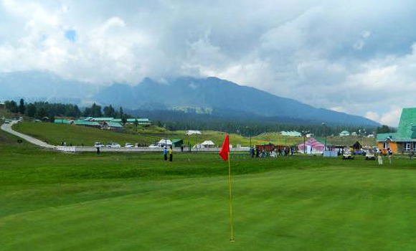
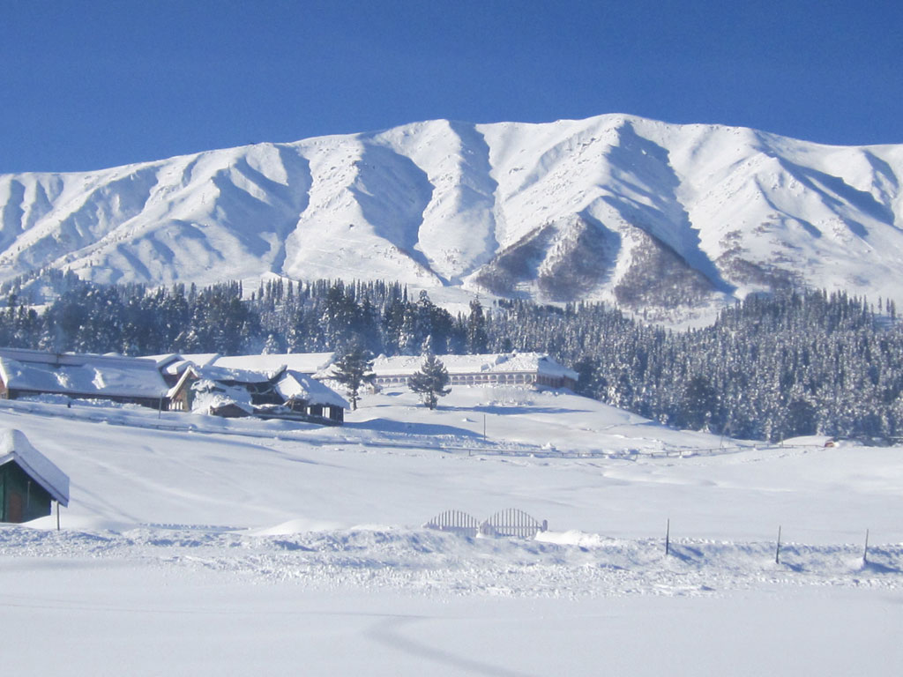
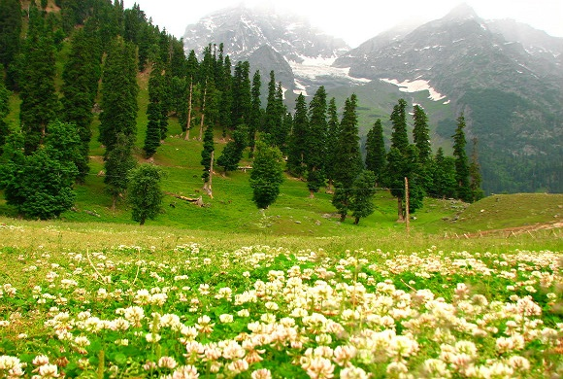
DAY 2 – GULMARG Day Trip
Wake up early, energize yourself with a heavy breakfast and start your day for visit of Gulmarg
Get a tour of Gulmarg greenery which includes visit to Golf Club, Maharaja Palace, Strawberry valley, Nageen Valley.(separate cab/ponies required)
You cannot miss the ride of Gondola in Gulmarg, which is one of the highest cable rope car in the world and will include a halt at Kongdoori and Afarwat. The glaciers of khilanmerg and Afarwat will leave you enthralled and cast a mark on your memory.
Get amused with the level 1 of Snow Ski in Gulmarg with a dedicated Ski guide.
Satiated with the day of amusement, retire back to hotel for overnight stay.

Slide 8
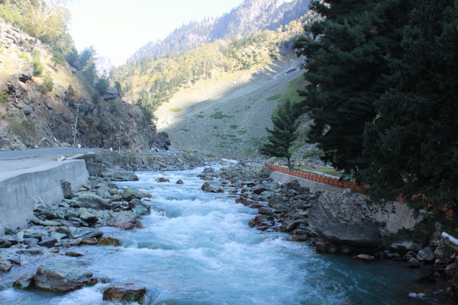
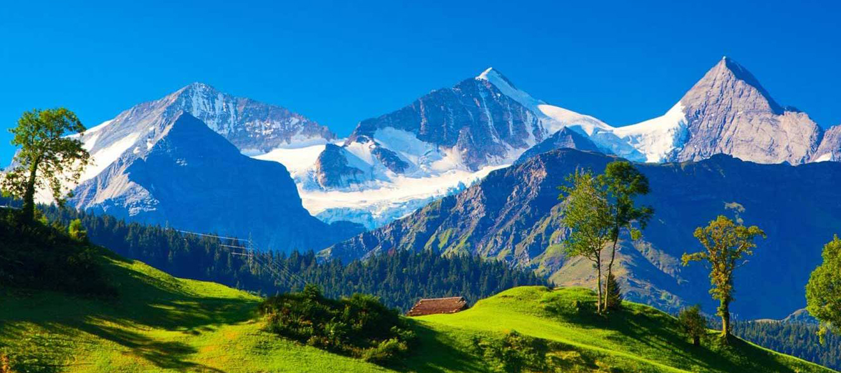
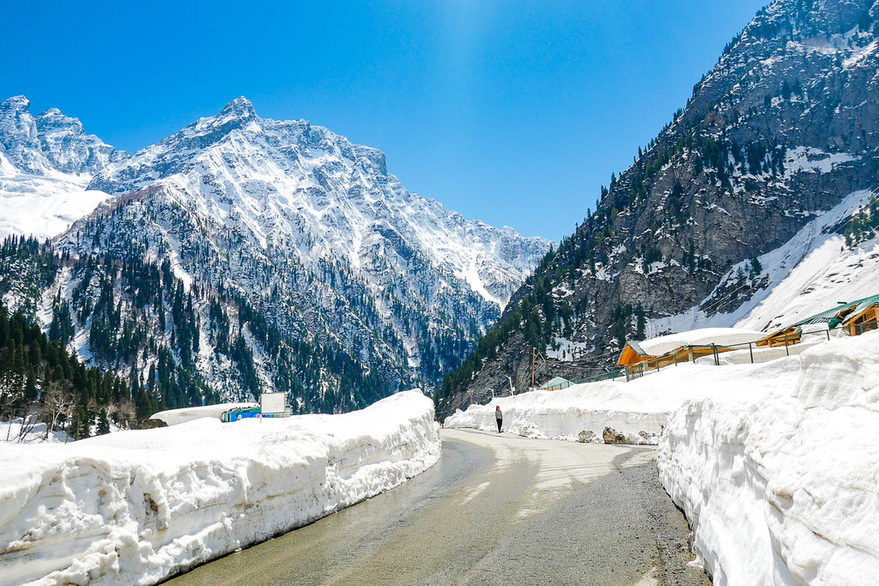
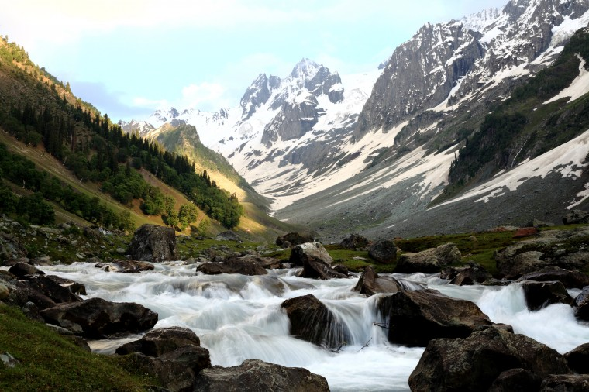
DAY 3 – Srinagar to songmarg
Enjoy your early breakfast and freshen up for a day of adventure and sightseeing.
Your personalized chauffer will drive you to Sonmarg. A drive of 2 hours will land you in Sonmarg, famous for glaciers and trekking.
Check in your hotel, get refreshed and move towards Thajwas glacier.
You will have to use ponies to reach the glacier.
You should also visit fish point in sonmarg for a small boat ride and zorbing ball.
If you have a nick for water and heights then white water rafting and trekking is a must in sonmarg.

Slide 9
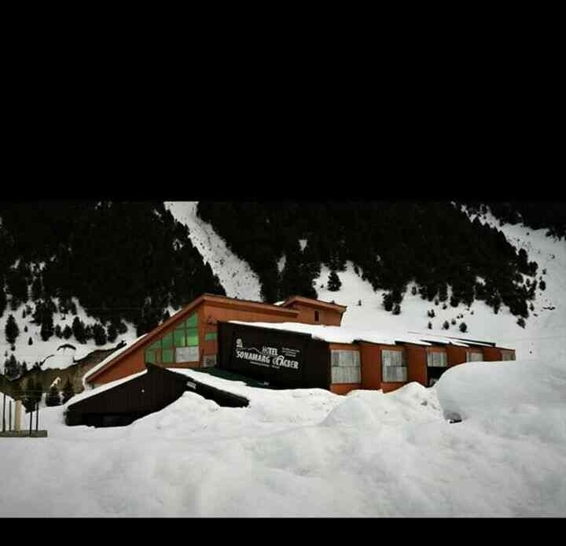
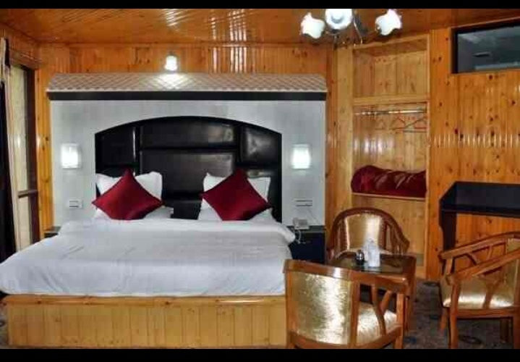
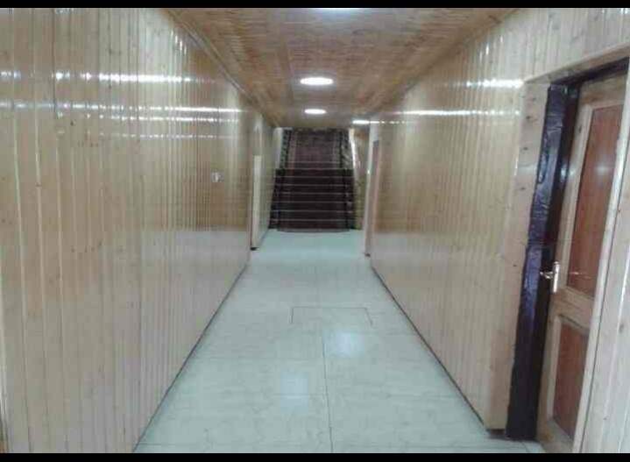
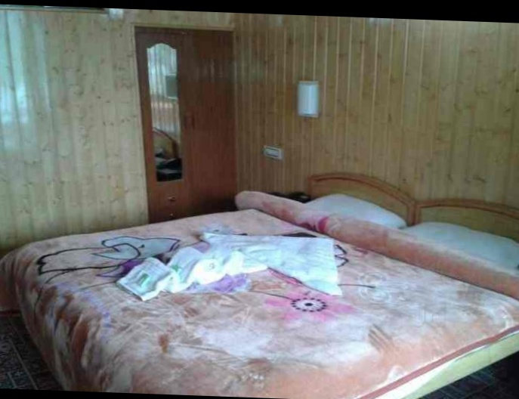
HOTEL SONGMARG GLACIER
Night: 3rd

Slide 10
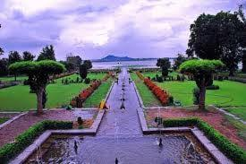
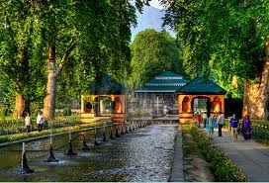
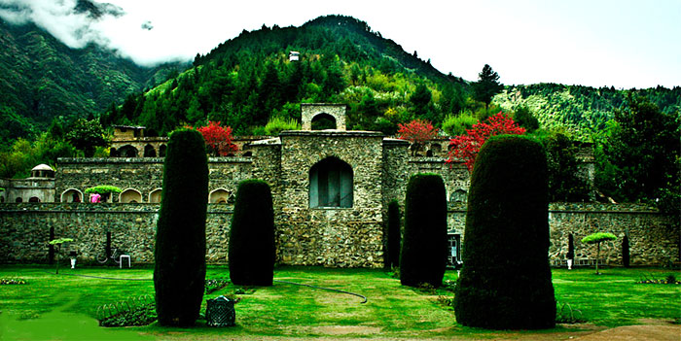
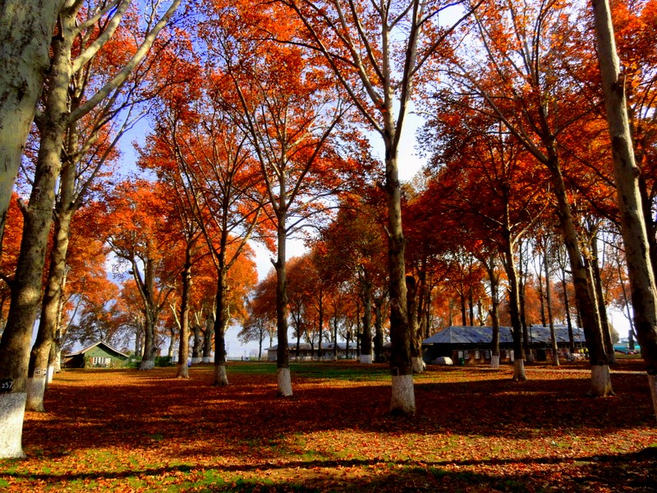
DAY 4 – Songmarg to srinagar with local sightseeing
Your personalized chauffer will drive you back to Srinagar with wonderful memories of sonmarg.
Check in your hotel to freshen up for a day tour of world famous Tulip Garden (Only for the month of April). It is the largest tulip garden in Asia spread over an area of about 30 hectares with millions of tulips. The hues of tulip flower will enhance your visual effects of color.
A trip to Srinagar without visiting Mughal gardens is incomplete. Mesmerize yourself with the Mughal Gardens of Emperor Shahjahan which include Shalimar Garden, Nishat Garden and Cheshmashahi Garden.
A day without a visit to famous Hazratbal Mosque is injustice to the tour. The mosque is an engineering marvel with a mesmerizing view of Nageen lake. The mosque is famous for the presence of holy relic which is believed to be many strands of hair of Prophet Muhammad's beard.
If you have love for history then a visit to Parimahal and Shankar Acharaya temple is a must. Parimahal which once was a court of Music for Mughal Emperor Shah Jahan is a must visit and will enthrall you to the beauty of whole dal Lake. Shankaracharya temple which dates back to 300 BC and is dedicated to Lord Shiva is a historical place to visit.
Return to your hotel with vivid memory of Kashmir for an overnight stay.

Slide 11
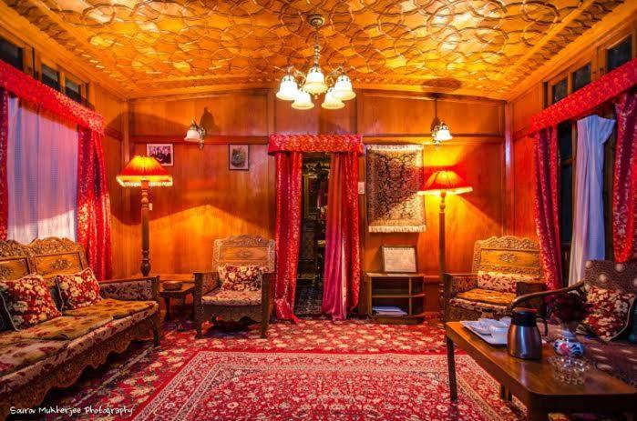
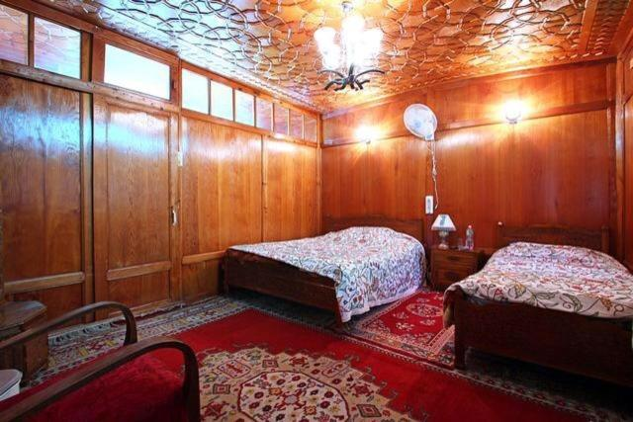
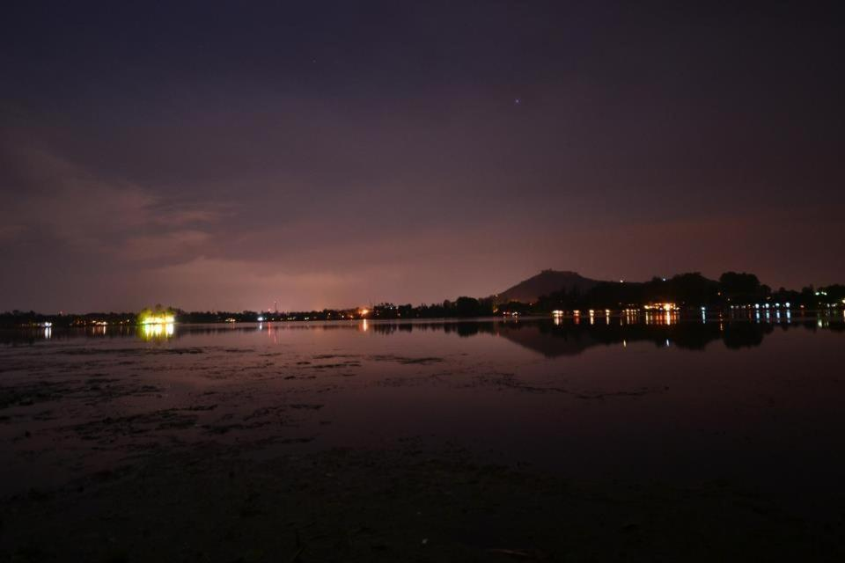
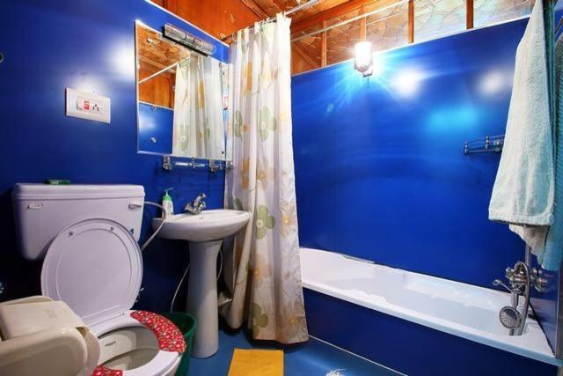
Houseboat Lily of Nageen
^{Location: Srinagar}
Night Stay:
4th

Slide 12
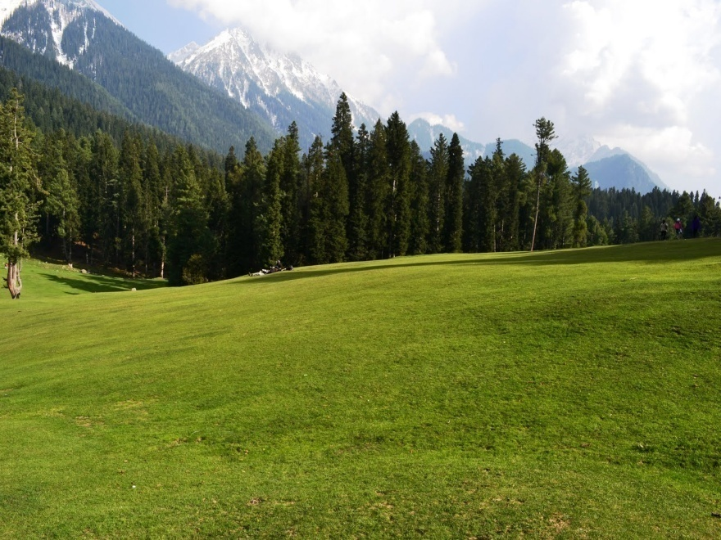
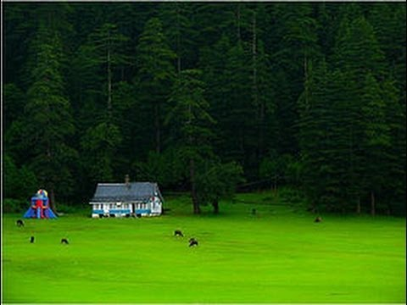
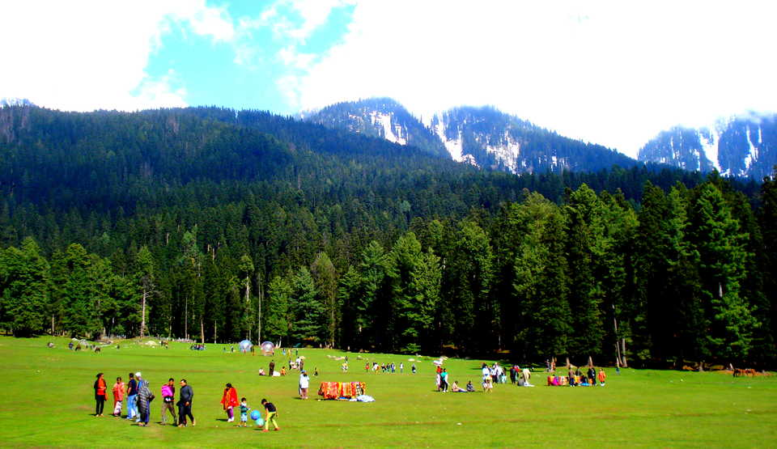
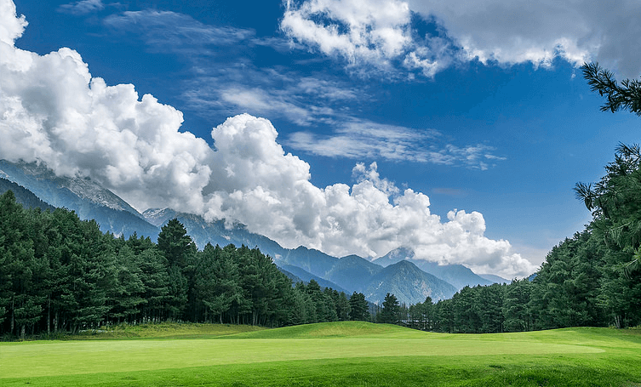
DAY 5- SRINAGAR TO PAHALGHAM
After your pickup move towards Pahalgam
Your personalized chauffer will drive you to Pahalgham. A drive of 2 hours will land you in Pahalgham.
During your travel on your way you can visit the Awantipora Ruins and Saffron fields. Awantipora ruins are a number of ancient Hindu temples built by King Avantivarman (AD 855- 883) when he chose the site as his capital.
Check in your hotel to freshen up for a day tour to the Bollywood city of Kashmir.
You will be mesmerized with the beauty of river lidder.
Retire back to your hotel for a delicacies of dinner and comfort of your bed with cherishable memories.

Slide 13
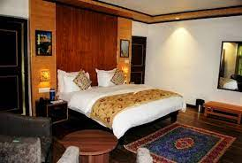
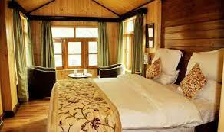
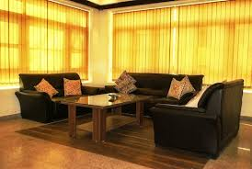
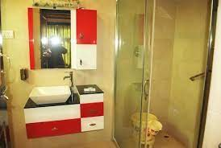
HIMALYAN HILLS
Location :- Pahalgam Rafting Point
^{5th} 6th Night Stay

Slide 14
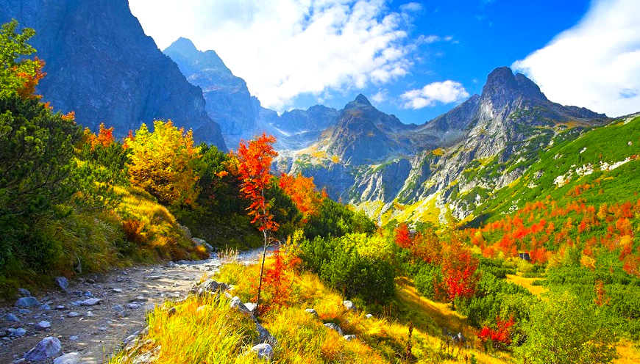
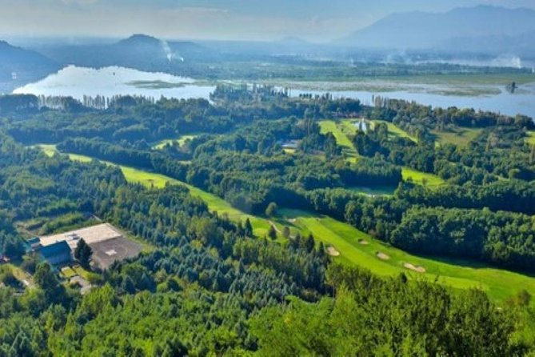
DAY 6- IN PAHALGHAM
Enjoy your breakfast and freshen up for a day of valley visits. You will be mesmerised by the beauty of Betaab valley , Chandanwari and Aru valley.
If you want to ride ponies then a visit of Baisaran valley is a must.
You will be mesmerized with the beauty of river lidder.
Other attractions are Pahalgam club, Children's park, Zoo and Golf club
Retire back to your hotel for a delicacies of dinner and comfort of your bed with cherishable memories.

Slide 15
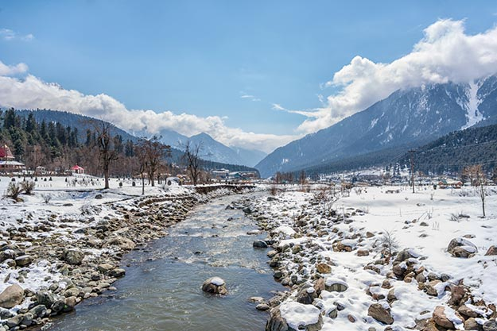
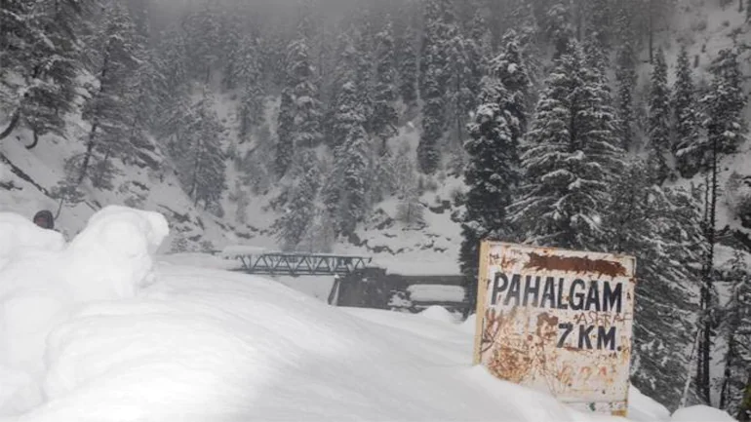
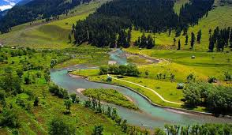
Day 7: Pahalgam to Srinagar with Local sightseeing
Enjoy your breakfast and freshen up for a day of valley visits. You will be mesmerised by the beauty of Betaab valley , Chandanwari and Aru valley (Separate Cab Required)
Later move towards Srinagar
A drive of 2 hours will land you in Srinagar. During your travel on your way you can visit the Awantipora Ruins and Saffron fields. Awantipora ruins are a number of ancient Hindu temples built by King Avantivarman (AD 855- 883) when he chose the site as his capital.
Check in at houseboat for a delicacies of dinner and retire to your bed with cherishable memories.

Slide 16
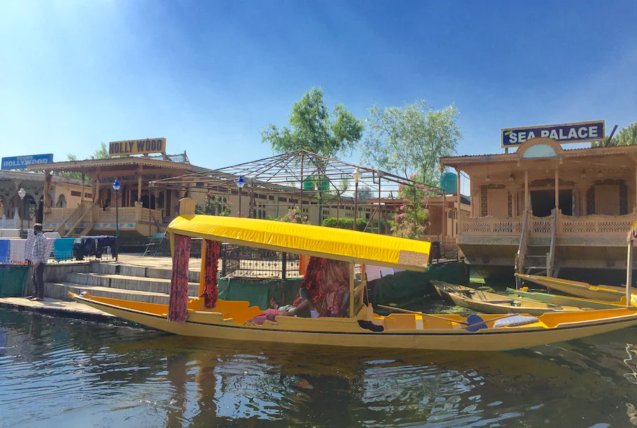
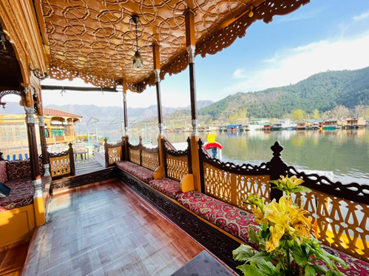
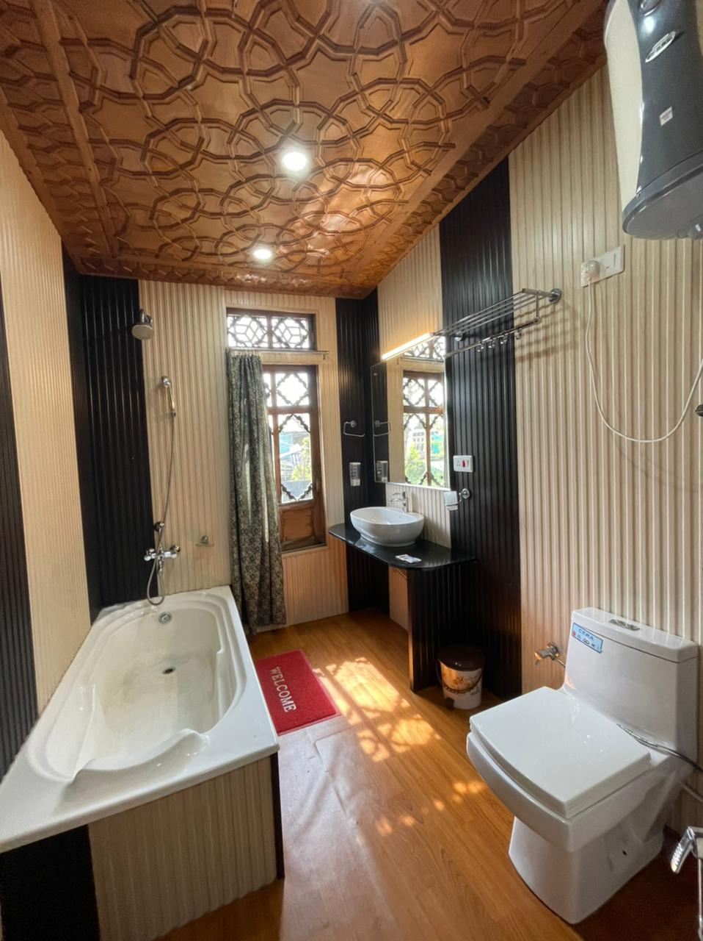
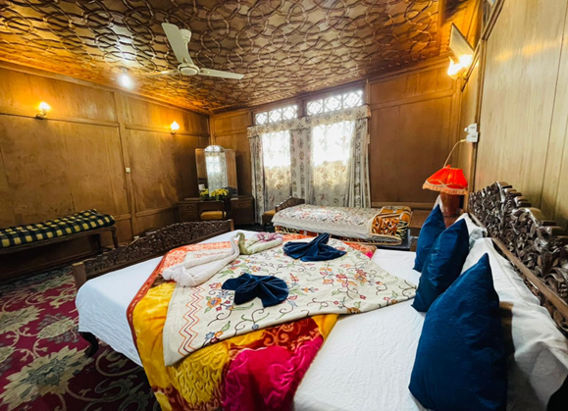
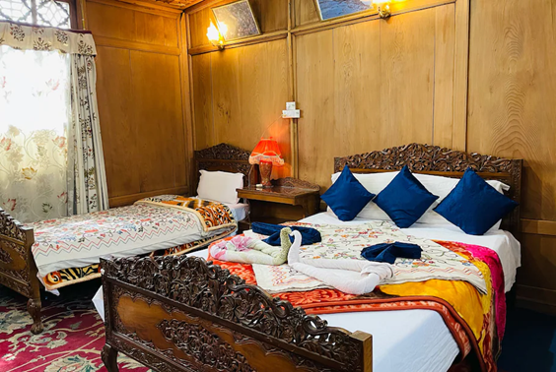
New Sea Palace Group of Houseboat
Night : 7th
Location : Dal Lake Srinagar

Slide 17
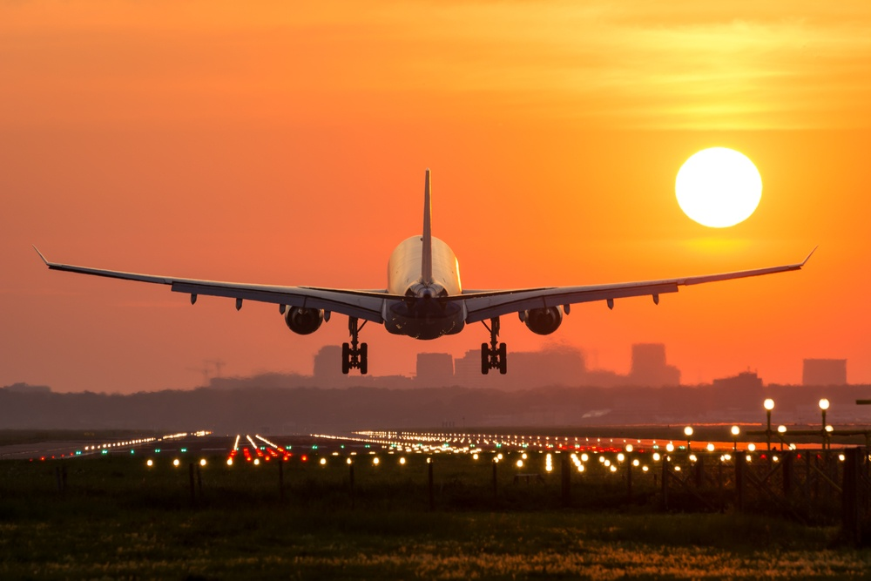
DAY 08–DROP SRINAGAR AIRPORT
Enjoy your early breakfast and freshen up with vivid memories of Kashmir.
Your personalized chauffer will drive you to Srinagar.

Slide 18
INCLUSIONS
01 Deluxe Room on daily basis
One Etios at disposal from pick up at srinagar Air Port till drop at srinagar Air Port
Daily Breakfast and Dinner
One hour shikara ride in Dal lake
Service tax
Parking charges
Driver allowances
24/7 over the phone support
Meet and greet upon arrival
Tolls and taxes
Doctor on call facility
Medical kit

Slide 19
EXCLUSIONS
Lunch | Pre-paid SIM’s Don’t work here.
Any activity not mentioned in the inclusions
Horse Ride
Gondola Tickets
Union taxi Pahalgam.
Snow Jeep

Slide 20
HOW MUCH DOES IT PINCH YOUR POCKET?
COST
OF PACKAGE
No of Adults | Price per Adult | Total Price
02
No of Children | Price per Child | Total Price
00
GRAND TOTAL |  | 68.500
How are you Going to Pay..?
Your package becomes active only once you make an initial advance payment of INR 30,000.
We will be issuing you vouchers for the hotels and provide you details about the driver and guide.
Payment can be made through online transfer to our bank accounts.
Balance amount should be paid through online transfer on arrival in Kashmir.

Slide 21
HOW ARE YOU GOING TO PAY?
GPAY NUMBER :7889419159
BANK NAME | HDFC BANK
ACCOUNT NUMBER | 59207889419159
ACCOUNT NAME | TOTAL TRIP HOLIDAYS
ACCOUNT TYPE | CD TYPE
BRANCH ADDRESS | HDFC SOPORE
IFSC CODE | HDFC0000859

Slide 22
TERMS AND CONDITIONS
Please note that any cancellation made before 20 days of arrival shall be Refunded with 5 percent service charges and cancellation made within 20 days of Arrival will be considered as no show
For First two installment you may deposit a cheque or make Neft payment in Our accounts given below, Balance payment shall be made by cash or Neft only
The cost of the flight tickets need to be paid in full and in advance in order to confirm the flight tickets. Any change in the cost of flights at the time of booking will be intimated to you and booked only after your confirmation. Variation in cost of flights is beyond the control of Total trip holidays and hence Total trip holidays cannot be held accountable for the change in flight cost.

Slide 23
Total Trip Holidays
Contact Details:
Phone:
+91 78894 19159, +91 9906 504093
Email: info@totaltripholidays.com
Website: www.totaltripholidays.com
THANKS & REGARDS
MUZAFFAR NADWI
7006529893

